Slide 1
Learner Wellbeing
The Cambridge Approach
Lucila Márquez - Senior Manager Latin America (Southern Cone & Andes)
British Council Schools Conference, Bogota, April 2024

Slide 2

We work with schools worldwide to build an education that shapes knowledge, understanding and skills.
Together, we give learners the confidence they need to thrive and make a positive impact in a changing world.

Slide 3

Learner Wellbeing:
The Cambridge Approach

Slide 4
Our key questions for today
What is wellbeing in schools?
Why is wellbeing in schools such an important issue?
Why is wellbeing worth evaluating or assessing?
How can we improve wellbeing in our schools?

Slide 5
1. What is wellbeing in schools?

Slide 6
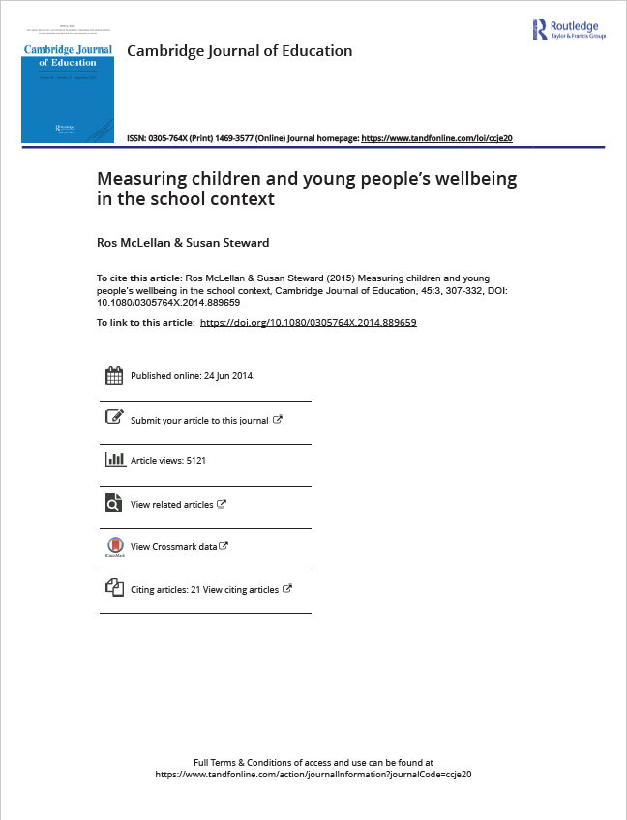

Our approach is based on research by colleagues in the Faculty of Education, Cambridge University (McLellan & Steward, 2015).
McLellan, R. & Steward, S. (2015) Measuring children and young people’s wellbeing in the school context, Cambridge Journal of Education, 45:3, 307-332.

Slide 7
A focus on psychological wellbeing
“The aim of positive psychology is to begin to catalyse a change in the focus of psychology from preoccupation only with repairing the worst things in life to also building positive qualities”
(Seligman & Csikszentmihalyi, 2000, p. 5)
Adopting a wellbeing-for-all perspective (positive psychology)
Conceptualising wellbeing in relation to school

Slide 8
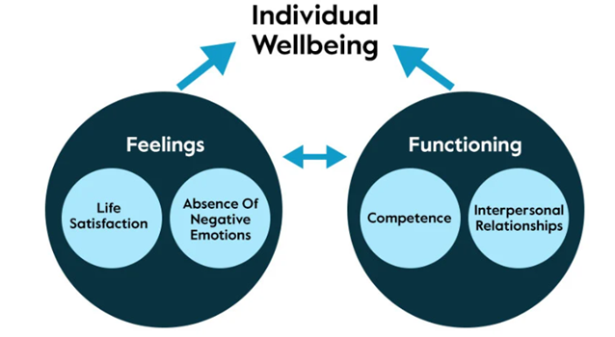
Model of individual wellbeing
Perceived competence in what we do, and interpersonal relationships
Connectedness with others
From their own, subjective point of view
Dr Ros McLellan,University of Cambridge Faculty of Education

Slide 9

The theories behind the model
Theory of Flow
(Csikszentmihalyi, 1975, 1990, 1992)
Total absorption in an activity, functioning at fullest capacity
Leuven Scales
(Laevers et al., 2011)
Wellbeing as conceptualised as affective
Distinct from 'involvement'
Self-Determination Theory
(Deci & Ryan, 2000)
Competence
Autonomy
Relatedness
Subjective Wellbeing
(Diener et al., 1990s onwards)
Affect (positive & negative)
Life satisfaction
Defined relative to specific domains in life
Hierarchy of needs (Maslow, 1954)
Self-actualisation at the apex of the hierarchy

Slide 10
A simple definition by Cambridge of wellbeing in schools
Wellbeing is about
how individuals feel and function in the context of education.
(Ros McLellan, 2014)

Slide 11

Discussion:
What indicators or signs could you use to identify levels of student wellbeing?

Slide 12
What indicators or signs could you use to identify levels of student wellbeing?
Wellbeing domains* | Possible indicators (not an exhaustive list)
Material | clothing, possessions, surrounding environment
Physical | health status, physical exercise, healthy diet
Social/Interpersonal wellbeing | social integration, social acceptance, social contribution
Cognitive/Competence | educational attainment, sense of purpose, academic skills, academic mastery
Psychological/Feelings | life satisfaction, positive or negative emotions, personal growth
**Borgonovi, F, & Pal, J. (2015). A Framework for the analysis of student well-being in the PISA 2015 study. OECD Education Working Papers No.140.

Slide 13

Wellbeing is subjective
So, we must ask children about their wellbeing

Slide 14

Measuring subjective wellbeing
‘There has been an acknowledgement of the importance of children’s well-being in recent policy making, and the need to ask children themselves about their well-being (rather than relying on adults) is now commonly accepted’ (p7).
https://www.childrenssociety.org.uk/sites/default/files/2022-09/GCR-2022-Full-Report.pdf

Slide 15
2. Why is wellbeing in schools such an important issue?

Slide 16

Wellbeing has intrinsic value.

Slide 17
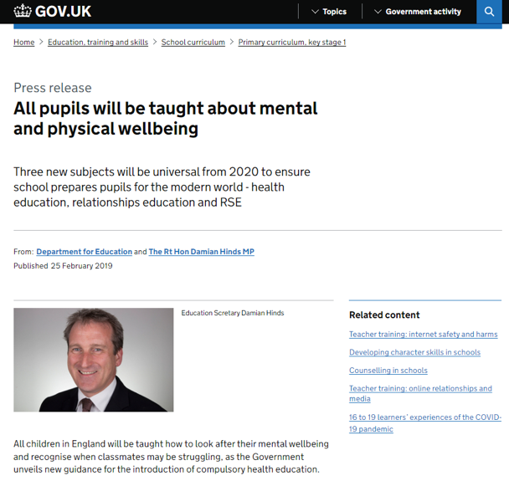
A good education is about much more than cognitive development.
"Today's children will need a balanced set of cognitive, social and emotional skills in order to succeed in modern life."
                OECD, 2015

Slide 18
What does educational success look like?
Qualifications and certificates
Progression to next level of education or employment
A good citizen
High wellbeing
(feeling well and functioning well)
Life competencies/
21st century skills
A holistic view of educational success

Slide 19

Wellbeing is linked with academic success
https://oxfordimpact.oup.com/home/wellbeing-impact-study/

Slide 20



160
countries

Slide 21


3. Why is wellbeing worth evaluating or assessing in schools?

Slide 22
If one does not know to which port one is sailing, no wind is favorable.
Lucius Annaeus Seneca

Slide 23

Assessment supports improvement

Slide 24
4. How can we improve wellbeing in schools?

Slide 25
A wellbeing ecosystem
Attitudes and ideologies of the culture
Neighbours
Media
Family
Peers
Individual learner
Social services
School
Religion
Health services
Adapted from Bronfenbrenner, 2005
Industry
Politics

Slide 26
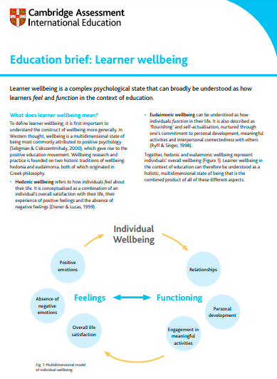

Education brief and animation
https://www.cambridgeinternational.org/support-and-training-for-schools/leading-learning-and-teaching-with-cambridge/education-briefs-and-animations/

Slide 27
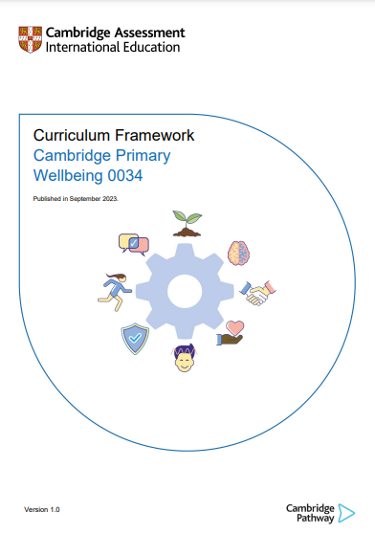
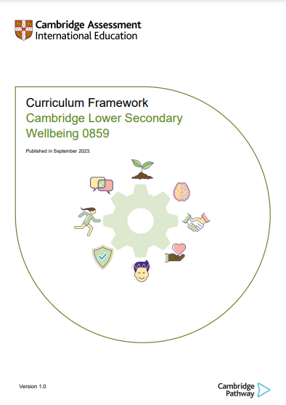

Slide 28
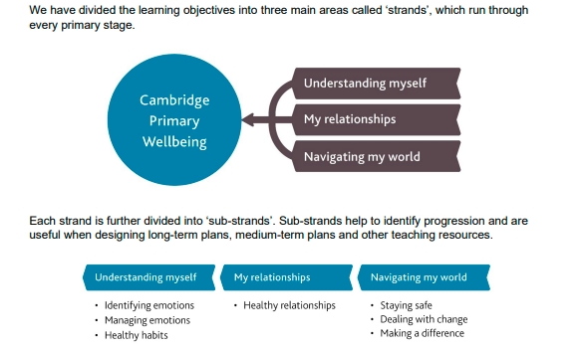

Slide 29
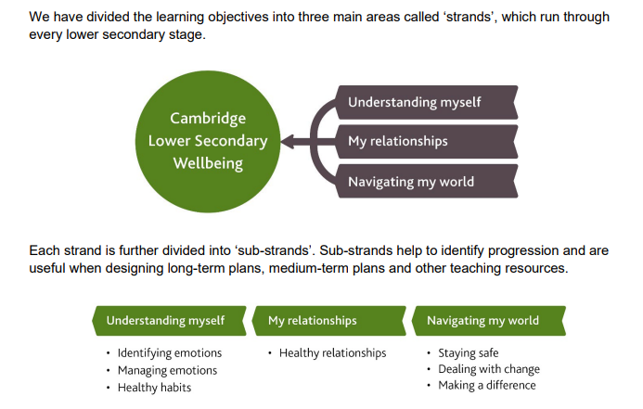

Slide 30
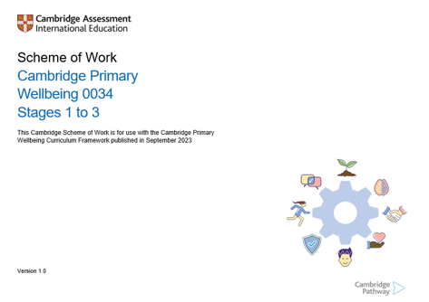
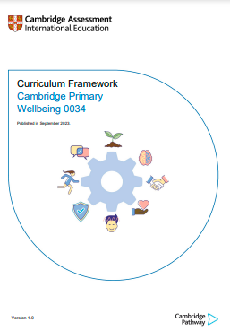
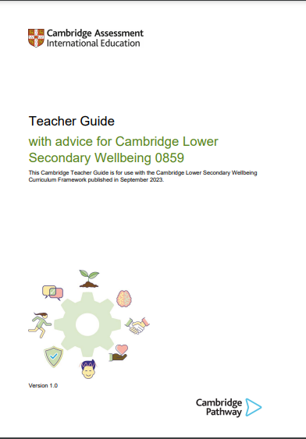


Slide 31

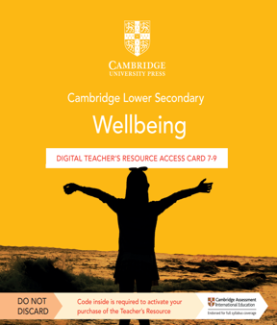

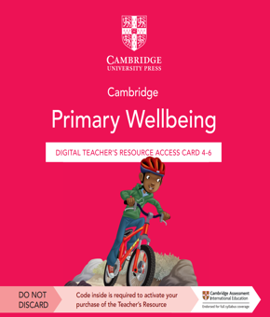
https://www.cambridgeinternational.org/programmes-and-qualifications/cambridge-primary/curriculum/wellbeing/
https://issuu.com/cupeducation/docs/cambridge_reading_adventures_guide
https://www.cambridgeinternational.org/programmes-and-qualifications/cambridge-lower-secondary/curriculum/wellbeing/

Slide 32

New statement on Climate Education: working together for change
Mental health and wellbeing
High-quality climate change education also has space to address eco-anxiety among students. Eco-anxiety (also known as eco-distress or climate anxiety) is ‘a way of describing how people feel when they hear bad news about our planet and the environment’. These reactions can include feeling ‘anxious, worried, upset, scared, sad, angry or unsure about the future’.
https://www.cambridgeinternational.org/why-choose-us/benefits-of-a-cambridge-education/climate-change-education/
https://www.cambridgeinternational.org/Images/707181-climate-change-education-introduction-paper.pdf

Slide 33

A practical tool for assessment
The Cambridge
Wellbeing Check
A CEM Assessment
The Cambridge
Wellbeing Check
A CEM Assessment
The Cambridge
Wellbeing Check
A CEM Assessment
The Cambridge
Wellbeing Check
A CEM Assessment Check
A CEM Assessment
A clear picture of wellbeing,
from a whole-school view down
to individual students.
A clear picture of wellbeing,
from a whole-school view down
to individual students.
A clear picture of wellbeing,
from a whole-school view down
to individual students.
https://www.cem.org/

Slide 34

The Cambridge Wellbeing Check
Digital
For ages 7 to 18
No paperwork or marking
Quick and easy to set up and use
22 questions
Flexible: fits around lesson plans and school day
Assess students several times each year

Slide 35

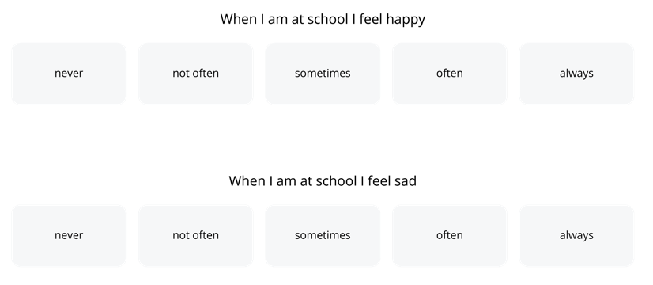

The assessment – example questions

Slide 36
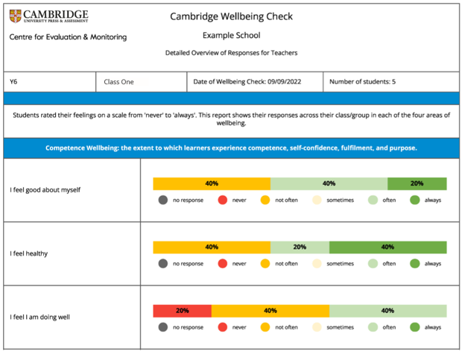
Suite of 12 reports
E.g. Detailed overview of responses showing how the group responded to each question. It shows the percentage of students who chose each response option.

Slide 37
Four uses of wellbeing assessments
Teach and explore wellbeing with students
Evaluate the wellbeing of groups of students
Understand individual students' wellbeing levels
Evaluate the impact of interventions to improve wellbeing

Slide 38

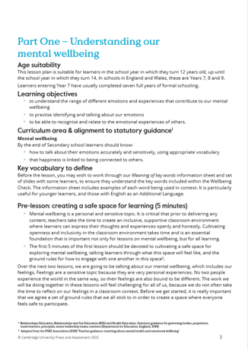
Lesson plans
Pre- and post- check lesson plans for each of:
Lower Primary (ages 7 – 9) - lower Key Stage 2
Upper Primary (ages 9 – 11) - upper Key Stage 2
Lower Secondary (ages 11 – 14 ) - Key Stage 3
Upper Secondary (ages 14 – 16) - Key Stage 4
Post-16 (ages 16 – 19) – Key stage 5

Slide 39


Slide 40
Next steps

Slide 41
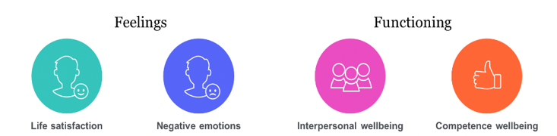
What could we measure in wellbeing?

Slide 42
Getting started
Clarify the pertinent wellbeing issues in your school.
What are the priority areas to focus upon?
Spend a couple of minutes thinking about your school. Where is a need for wellbeing most evident?
Relationships among students/staff?
Teacher-student relationships?
High stress levels?
Little sense of making progress?
New students don't 'belong' yet?
Or...?

Slide 43
Once you know what you want to focus on, you could
Develop a whole-school approach or strategy around wellbeing
Identify teacher strategies and activities for improving wellbeing in the focus areas
Action Research

Slide 44

Supporting a whole school approach to wellbeing
Freely available to all from gov.uk
This document describes 8 principles of a whole school or college approach to promoting mental health and wellbeing.
https://assets.publishing.service.gov.uk/government/uploads/system/uploads/attachment_data/file/1020249/Promoting_children_and_young_people_s_mental_health_and_wellbeing.pdf

Slide 45
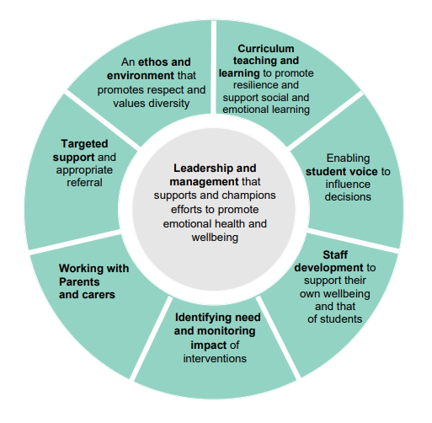
Eight principles to promoting a whole school approach to mental health and wellbeing
https://assets.publishing.service.gov.uk/government/uploads/system/uploads/attachment_data/file/1020249/Promoting_children_and_young_people_s_mental_health_and_wellbeing.pdf

Slide 46

Just one thing teachers can do..
…make sure that every child has formed at least one strong and supportive professional relationship with a teacher.

Slide 47
Thank you.
Any questions?
lucila.marquez@cambridge.org
www.cem.org/wellbeing

