Slide 1

DEVELOPING LEADERSHIP SKILLS
IN PERUVIAN HIGH SCHOOL STUDENTS
Dr. César Morales C.
COLEGIO SAN ANDRÉS, Lima-Perú

Slide 2


Slide 3


Slide 4


Slide 5


Slide 6
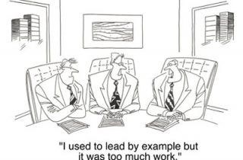

Slide 7




BACKGROUND
ACTION RESEARCH GRANTS
Developing Leadership Skills in Peruvian High School Students
Researcher: Cesar Morales
DATA TOOLS
- There is a lack of trust in Peruvian leaders and there are no models to follow.
- New leaders should be prepared for future, but what students think about leadership and about what leaders need?
- Do students and their teachers think the same about this topic?
- Focus groups with
students
- Interviews with
teachers
- Journal reflection
RESEARCH QUESTIONS
What do senior students in Peruvian high schools currently think about leadership?
In what ways do the perceptions of leadership
among senior students differ or resemble those
held by their teachers?
What components should be included into a
leadership program designed for Peruvian
high school senior students?
ACTIONS
- A leadership development program for teenagers is necessary.
- This program should focus on developing practical skills (public speaking, teamwork, etc.) more than theoretical knowledge.
FINDINGS
CONCLUSIONS
- Effective leadership is posible in Peru.
- Students showed more hope in the
future than teachers.
- Integrity and honesty are two main
characteristics of good leaders.
- While students demand more freedom to
make decisions, teachers want more
control over students’ decisions.
- Leadership is important for a country.
- Students expect a future with greater
hope than teachers. Teachers play a main
role building students’ dreams.
- Developing leadership skills in students
demands intentional commitment of the school and its authorities.

